Slide 1
50 Java keywords
abstract assert boolean break
byte case catch char
class const continue default
do double else enum
extends final finally float
for goto if implements
import instanceof int interface
long native new package
private protected public return
short static strictfp super
switch synchronized this throw
throws transient try void
volatile while

Slide 2
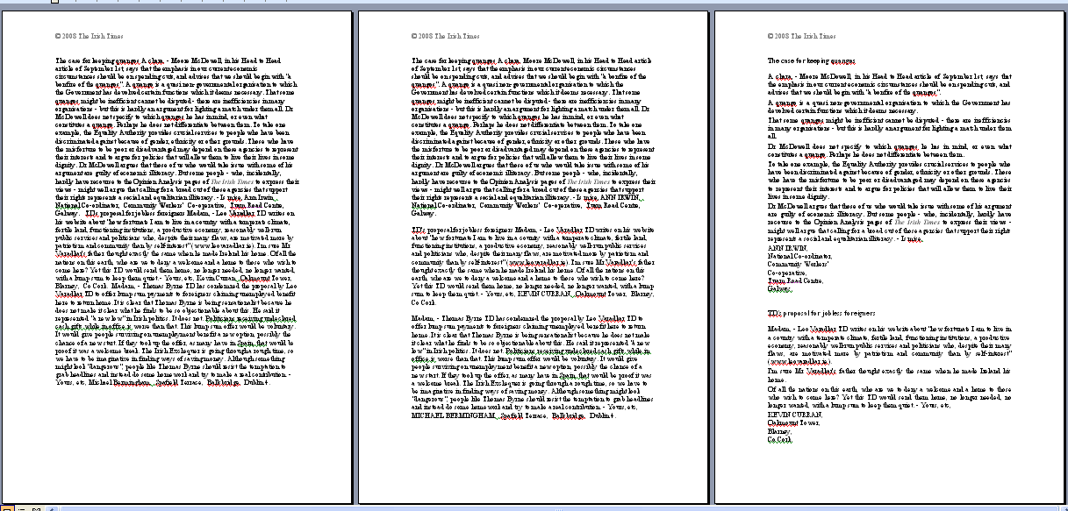
Text layout - Preferences

Slide 3
Class Design Issues
The organization of the class source code text can have significant implications for readers of it.
For example, for readability purposes we have used indentation to highlight loop bodies, if structures and so on.
We are under no obligation to use these typographical techniques but we do because they assist us when we need to review the source text to modify or correct it.
Notes:
1

Slide 4
Class Design Issues
Nobody writes a 10,000 line program – they write 1000 ten line programs!
The principal reason is that it is easier to write and understand a ten line program.
It is also easier to verify the correctness of it.
If we look at the class source file we notice that each operation provided is coded as a separate (usually short) collection of statements.

Slide 5
Program Layouts
In effect each one is a ‘10-line program’ that provides one operation for the class.
More correctly we might say that each one describes the method by which the operation can be realised.
As a consequence, in Java and other object oriented languages, these ’10-line programs’ are called methods.

Slide 6
Methods
Methods can be classified as being one of two types
  methods that perform an action and provide no feedback about the outcome – sometimes called procedures
  methods that perform an action and provide feedback about the outcome – sometimes called functions

Slide 7
Syntax of a method
A header, or signature as it is sometimes called, is the first part of a method that
  specifies who can use the method by including an access modifier (i.e. public or private)
  identifies the type of data returned by the method (i.e. if it is a function) or uses the keyword void if it is a procedure
  names the method
  describes any data required by (or passed to) the method – called the parameters of the method
Notes:
17

Slide 8
Syntax of a method
For example
public long getBatteryLevel()
can be
used
outside
class
method
name
you do not need to supply any data to use this method
this method provides
a long integer as
feedback (i.e. it’s a
function)

Slide 9
Syntax of a method
For example
public void sendText(String toNumber, String message)
can be
used
outside
class
method
name
to use the method
you must supply
two strings
this method provides
no feedback (i.e. it’s a
procedure)

Slide 10
Syntax of a method
The method header is followed by a definition or implementation that contains the statements required to achieve whatever it is the method does.
The implementation is enclosed in curly brackets to delimit the scope of the method.

Slide 11
The sendText method
public void sendText(String toNumber, String message)
{
if(signalLevel < USABLE_SIGNAL_LEVEL) {
setDisplay("Poor signal. Message cannot be sent.") ;
} else {
/**
* Create a text message object using the current time,
* the number of this phone (i.e. the sender), the number
* of the receipient's phone and the actual text of the message.
*/
Text txt = new Text(now(), number, toNumber, message);
/**
* Send the text message object to the provider and let them
* look after delivering it. The text object contains all the
* information the provider needs for billing (i.e. the sender's
* number and receipient's number - in case roaming charges apply).
* It also has all the information necessary for delivery.
*/
provider.sendText(txt);
}
}

Slide 12
The switchOn() method
public void switchOn()
{
if(batteryLevel < USABLE_BATTERY_LEVEL) {
screenOn() ;
setDisplay("Battery Low.....Charge the battery") ;
pause(1500) ;
clearDisplay() ;
screenOff() ;
} else {
signalLevel = checkSignal() ;
screenOn() ;
clearDisplay() ;
showLatestText() ;
switchedOn = true ;
timeSwitchedOn = now() ;
}
}

Slide 13
Longest Word?
Floccinaucinihilipilification*
  “the categorising of something as worthless or trivial” – OED
Floccinaucinihilipilificational
  Pertaining to the categorising of something as worthless or trivial
Floccinaucinihilipilificationalise
  To cause something to pertain to the categorising of something as worthless or trivial
Floccinaucinihilipilificationalisation
  The act of causing something to pertain to the categorising of something as worthless or trivial
*See page 131 of the Language Instinct – Steven Pinker

Slide 14
Longest Word?
Floccinaucinihilipilificationalisational
  Pertaining to the act of causing something to pertain to the categorising of something as worthless or trivial
Floccinaucinihilipilificationalisationalise
  To cause something to Pertain to the act of causing something to pertain to the categorising of something as worthless or trivial

Slide 15
Longest Word?
Floccinaucinihilipilification 30
Floccinaucinihilipilificational 32
Floccinaucinihilipilificationalise 35
Floccinaucinihilipilificationalisation 39
Floccinaucinihilipilificationalisational 41
Floccinaucinihilipilificationalisationalise 44

Slide 16
Longest Word?
Demon
Demonise
Demonisation
Demonisational
Demonisationalise
Demonisationalisation
Demonisationalisational

Slide 17
Strings
Unlike the integer and float data types a string is in fact a collection of individual characters.
Integers and floats can be inspected using the relational operators
  == < <= > >= !=
Unfortunately strings cannot because inspecting a collection of things is significantly different from inspecting a single value.
So whilst we can talk or think about strings using >, <, etc. we will have to write the string equivalents in a different style.

Slide 18
Strings
Strings have such widespread use that Java provides a special String class that supports all the string operations we may want to use.
To find out about strings we can refer to the string Application Programmer Interface (API) which details each of the methods provided by the String class.
In the following slides we will review some of the more frequently used methods only.

Slide 19
Strings - concatenation
A common operation with strings is to take two strings and join them together to form a single string.
String s = “University” ;
String t = “ of Limerick” ;
String ul = s + t ;
When applied to strings the + operation is interpreted to mean join (or concatenate) the strings to form a new string.

Slide 20
Strings - comparison
Given two strings S and T
  S.equals(T) is true is the two strings are exactly the same (i.e. it is case sensitive)
  S.equalsIgnoreCase(T) is true is the two strings have the same characters (i.e. it is case insensitive)
  S.compareTo(T) returns a negative value if S precedes T alphabetically, a zero value if S and T are exactly the same, and a positive value is S succeeds T alphabetically
  S.compareToIgnoreCase(T)?

Slide 21
Strings – Example 0
public void simpleTyperV0()
{
String key, typedText = “” ;
key = waitForKeyPress() ;
while(key.compareTo("enter") != 0)
{
typedText = typedText + key ;
addToDisplay(key) ;
key = waitForKeyPress() ;
}
}

Slide 22
Strings – Example 1
public void simpleTyperV1()
{
String key, typedText = “” ;
key = waitForKeyPress() ;
while(key.compareToIgnoreCase("enter") != 0)
{
typedText = typedText + key ;
addToDisplay(key) ;
key = waitForKeyPress() ;
}
}

Slide 23
Strings – Example 2
public void simpleTyperV2(String delimiter)
{
String key, typedText = “” ;
key = waitForKeyPress() ;
while(key.compareToIgnoreCase(delimiter) != 0)
{
typedText = typedText + key ;
addToDisplay(key) ;
key = waitForKeyPress() ;
}
}

Slide 24
Strings – Example 3
public String simpleTyperV3(String delimiter)
{
String key, typedText = “” ;
key = waitForKeyPress() ;
while(key.compareToIgnoreCase(delimiter) != 0)
{
typedText = typedText + key ;
addToDisplay(key) ;
key = waitForKeyPress() ;
}
return typedText ;
}

